Slide 1
Android Positioning Architecture
How Your Phone Determines Your Position
Based On
Android, Qualcomm & SUPL Location Architecture

Slide 2
Agenda
Introduction - The Location Challenge
System Architecture Overview
Android AOSP Stack
Qualcomm Hardware Architecture
SUPL Protocol Deep Dive
Complete Location Request Flow
Position Calculation & Mathematics
Performance & Real-World Metrics
Summary & Key Takeaways
Complete Technical Deep Dive: How Position is Determined
Topics Covered:
Android AOSP Location Framework
Qualcomm Modem & GNSS Integration
SUPL (Secure User Plane Location)
Complete Flow: Application → Satellite → Position

Slide 3
Complete System Overview
Android AOSP Stack
(Application → Framework → HAL)
↕
Qualcomm Hardware & Firmware
(SoC → Modem → Hexagon DSP → GNSS)
↕
SUPL Network
(Assistance Data Servers)
+
GPS/GLONASS/Galileo/BeiDou satellites orbiting at 20,000 km

Slide 4
Complete Android-Qualcomm-SUPL Location Flow
1. APPLICATION LAYER:
  └ User opens Maps → LocationManager.requestLocationUpdates()
2. ANDROID FRAMEWORK:
└ LocationManagerService → GnssLocationProvider.enable()
3. HAL INTERFACE:
└ IGnss.start() → Vendor HAL implementation
4. QUALCOMM VENDOR:
└ Location API → GNSS Daemon → Location Engine
5. SUPL ASSISTANCE (Parallel): SUPL Client → SUPL Server → Assistance Data
└ Satellite ephemeris, Reference time & location, Ionospheric corrections, Acquisition assistance (Doppler, code phase)
6. GNSS HARDWARE: RF Frontend → Acquisition → Tracking → Measurements
└ Uses assistance data to acquire fast (5-10s vs 30-60s), Tracks 8+ satellites (GPS, GLONASS, Galileo, BeiDou)
7. POSITION CALCULATION: Measurement Engine → Position Engine
├ Apply corrections (ionosphere, troposphere, clock), Least squares trilateration, Kalman filter smoothing
└ Output: Lat/Lon/Alt ±4m accuracy
8. CALLBACK CHAIN:
└ GNSS Engine → HAL → Framework → Application
9. USER SEES LOCATION: Blue dot on map, navigation route displayed
Total Time: 5-10 seconds (first fix), 1-3 seconds (subsequent)

Slide 5
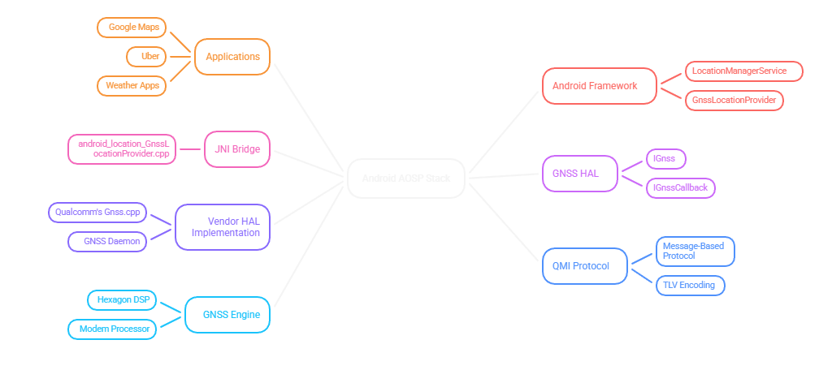
Android AOSP Stack For Location Services

Slide 6
Qualcomm Hardware Architecture
1. Application Processor (Kryo CPU)
  Runs Android OS
  ARM Cortex-based cores
  Handles apps and framework
2. Modem Subsystem
  Separate processor complex
  Handles cellular (4G/5G) communications
  Has its own CPU, memory, and OS
3. Hexagon DSP
  Digital Signal Processor
  Low-power, specialized processor
  Runs GNSS engine firmware

Slide 7
GNSS Engine Architecture
RF Frontend
Antenna and Low Noise Amplifier (LNA) + RF to baseband conversion + L1/L5 frequency reception (1.5 GHz)
↓
Acquisition Engine
Searches for satellite signals + Parallel correlators + Doppler frequency search
↓
Tracking Channels (12-32 channels)
Code tracking loop (DLL) + Carrier tracking loop (PLL) + One channel per satellite
↓
Measurement Engine
Generates pseudorange measurements + Doppler shift measurements + Carrier phase measurements + Signal strength (C/N0)
↓
Position Engine
Trilateration algorithm + Least squares solution + Kalman filtering + ECEF → Lat/Lon/Alt conversion
↓
SUPL Client
Downloads assistance data + Manages SUPL sessions

Slide 9
The Location Challenge
Why is GPS Positioning Hard?
  Traditional GPS Problems:
      Slow Time To First Fix (TTFF): 30-60+ seconds cold start
      Weak Signals: -160 dBm (weaker than a 25W bulb on the Moon)
      Data Download: 12.5-30 minutes for almanac/ephemeris from satellites
      High Power Consumption: Extended satellite search drains battery
      Poor Indoor Performance: Signals blocked by buildings
  Result: Bad user experience without assistance!
The Solution: A-GPS with SUPL

Slide 10
The Challenge of GPS
While the process of GPS positioning sounds straightforward, standalone GPS (operating without any assistance) faces several significant challenges:
1. Slow Time To First Fix (TTFF): It needs to download data from the satellites themselves in time of "Cold Start". This includes:
  Almanac Data: Approximate orbital information for all GPS satellites in the constellation.
  Ephemeris Data: Precise orbital parameters for each satellite, valid for about 4 hours. Receiver needs ephemeris for at least 4 satellites to get a position fix.
  Time Information: Receivers need to know the current GPS time to within a few seconds to begin the search for satellites efficiently.
Without this information, your phone must search through all possible satellite signals (32 satellites × many possible frequencies × many possible code phases), which can take 30 to 60 seconds or more just to get the first position fix.
2. Weak Signal Environments: GPS signals are remarkably weak by the time they reach Earth's surface. This presents several problems like poor indoor reception and inaccurate position calculation in Urban Canyons (In dense cities, GPS signals may be blocked or reflected off buildings (called multipath))
3. High Power Consumption: Searching for satellites and downloading data requires keeping the GPS receiver powered on for extended periods.
4. Limited Accuracy: Even under ideal conditions (clear sky, open area), standalone GPS typically achieves accuracy of 10-30 meters at a 95% confidence level.

Slide 11
The Solution: A-GPS with SUPL
Assisted GPS (A-GPS)
Key Concept: Download assistance data over fast internet instead of slow satellite signals
Speed Comparison:
  Satellite broadcast: 50 bits/second
  4G/5G internet: 20+ Mbps (400,000× faster!)
Result:
  TTFF: 5-10 seconds (vs 30-60 seconds)
  90% less power consumption
  Works in weak signal environments

Slide 12
Enter SUPL: The Solution
The fundamental insight behind SUPL is to send the assistance data quickly over the internet instead of making your phone slowly download that data from satellites:
Satellite Ephemeris Data: Instead of waiting 30 seconds per satellite to download ephemeris from the satellites themselves, SUPL can send precise ephemeris data for all visible satellites in just 1-2 seconds over a 4G or 5G internet connection. This ephemeris data is collected from a global network of GPS reference stations that continuously monitor all satellites.
Current GPS Time: SUPL provides the precise GPS time synchronized to within nanoseconds, eliminating the need for your phone to search blindly through time offsets.
Reference Location: SUPL can provide an approximate location based on your cellular connection (which cell tower you're connected to). This might only be accurate to 1-2 kilometers, but it's sufficient to tell your phone which satellites should be visible in the sky.
Acquisition Assistance: Perhaps most importantly, SUPL provides exact search parameters for each satellite, including The expected Doppler frequency shift, The expected code phase, The expected signal strength and satellite elevation angle
Ionospheric Correction Model: SUPL provides parameters for a mathematical model that can estimate the signal delay caused by the ionosphere, improving position accuracy by 5-15 meters.

Slide 13
SUPL Introduction
Secure User Plane Location Protocol
What is SUPL?
  OMA (Open Mobile Alliance) standard
  IP-based location protocol using User Plane
  Provides Assisted GNSS (A-GNSS) data
  Faster TTFF and improved accuracy
Key Principle: Use existing IP connectivity (cellular data/WiFi) to deliver GPS assistance data instead of downloading it slowly from satellites.

Slide 14
SUPL Protocol Overview
Developed by: Open Mobile Alliance (OMA)
  SUPL 1.0 (2007)
  SUPL 2.0 (2012)
Key Innovation: Use IP network (user plane) instead of cellular control plane
Benefits:
  Network-independent (works over WiFi, 4G, 5G)
  Simpler deployment
  Lower infrastructure cost
  Better roaming support
  Single standard for all networks

Slide 15
SUPL 2.0: Beyond GPS, Multi-Constellation GNSS
Constellation | Country | Satellites | Frequency Bands | Coverage | Status
GPS | USA | 31 operational | L1 (1575.42 MHz), L5 (1176.45 MHz) | Global | Fully operational
GLONASS | Russia | 24 operational | L1 (1602 MHz), L2 (1246 MHz) | Global | Fully operational
Galileo | EU | 28 operational | E1 (1575.42 MHz), E5a (1176.45 MHz) | Global | Fully operational
BeiDou | China | 49 operational | B1 (1561.098 MHz), B2 (1207.14 MHz) | Global | Fully operational
QZSS | Japan | 7 operational | L1, L5, L6 | Asia-Pacific | Regional
NavIC | India | 7 operational | L5, S-band | India ±1500km | Regional
Benefits:
  More visible satellites (12+ typically), Better geometry → lower DOP
  Improved accuracy of at least 3-5 meters with Faster TTFF
  Better urban canyon performance

Slide 16
SUPL Architecture: 2 Main components
1. SET (SUPL Enabled Terminal)
  Your mobile device
  Contains SUPL client software
  GPS/GNSS receiver
  IP connectivity
2. SLP (SUPL Location Platform)
  Network server (e.g., supl.google.com)
  Provides assistance data
  Can calculate position (SET-Assisted mode)
  SLP consists of:
    SLC (SUPL Location Center): Session management
    SPC (SUPL Positioning Center): Position calculation

Slide 17
SUPL Session Flow
Network-Initiated (Proxy Mode)
SET-Initiated (Non-Proxy Mode)
LCS Client → SLP: Location request (MLP)
SLP → SET: SUPL INIT (trigger)
SET → SLP: TLS connection established
SET → SLP: SUPL POS INIT (capabilities)
SLP → SET: SUPL POS (assistance data)
SET ↔ SLP: SUPL POS (positioning protocol)
SLP → SET: SUPL END (position result)
SLP → LCS Client: Location response
App → SET: Request location
SET → SLP: SUPL START (request assistance)
SLP → SET: SUPL RESPONSE (acknowledge)
SET → SLP: SUPL POS INIT (request data)
SLP → SET: SUPL POS (assistance data)
SET: Calculate position locally
SET → SLP: SUPL END (session complete)
SET → App: Location delivered

Slide 18
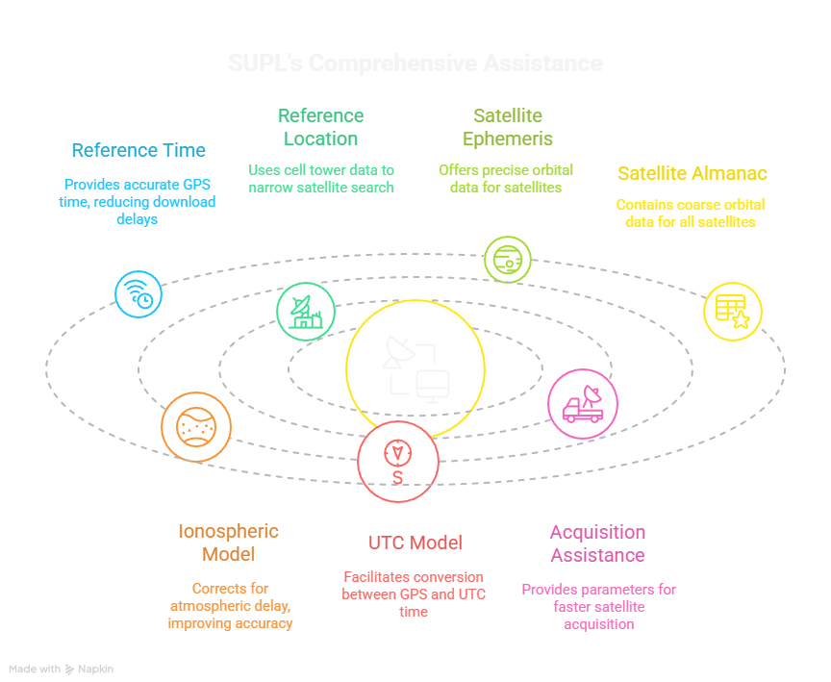

Slide 19
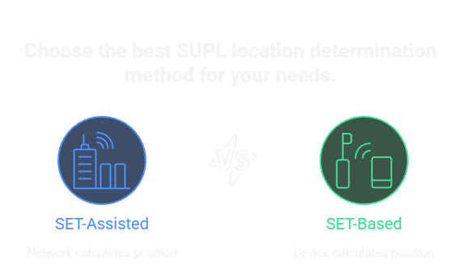

Slide 20
Position Calculation Methods
SET-Based (MS-Based)
"Device measures
and calculates"
SET-Assisted (MS-Assisted)
"Device measures,
network calculates"
SLP provides assistance data
SET acquires satellites
SET calculates position locally
Better privacy, works offline after assistance
Preferred by Android devices
SLP provides assistance data
SET makes GPS measurements
SET sends measurements to SLP
SLP calculates and returns position
Better accuracy, lower device power

Slide 21
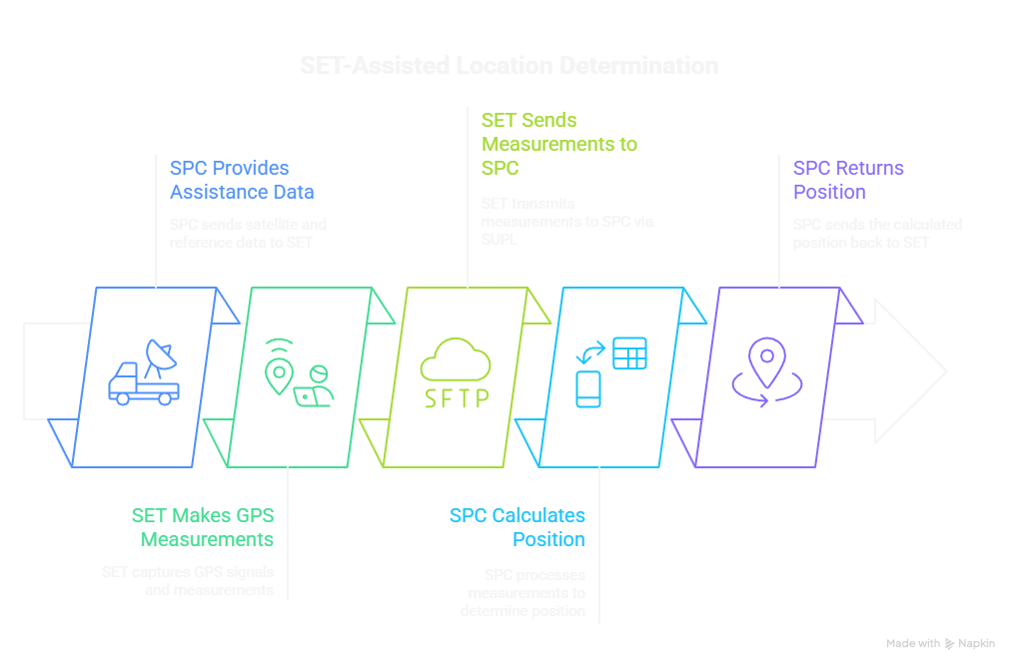

Slide 22
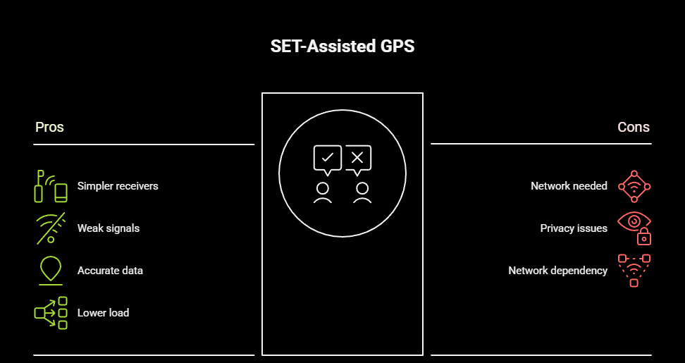

Slide 23
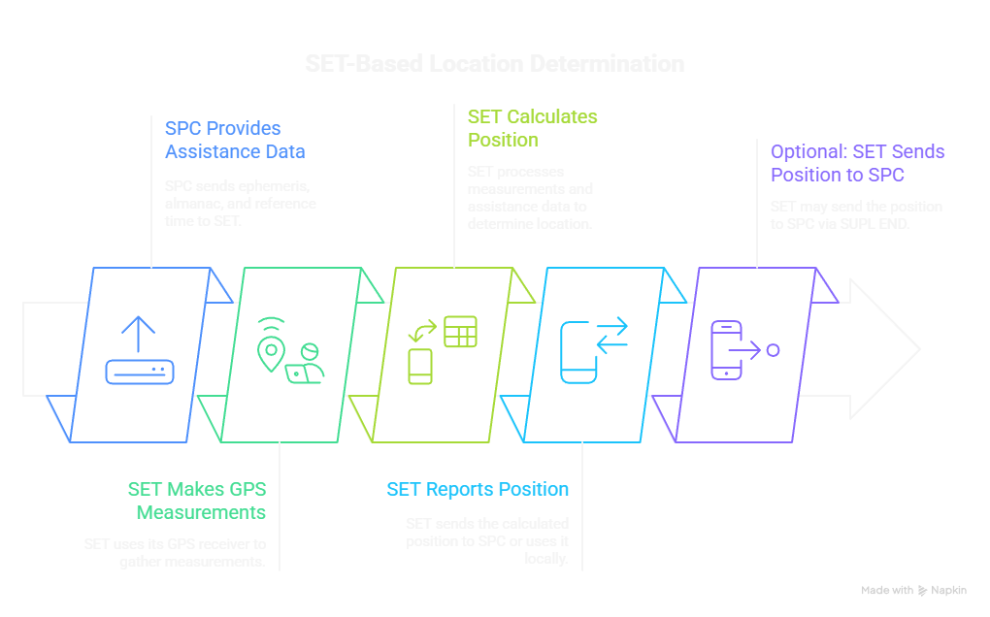

Slide 24
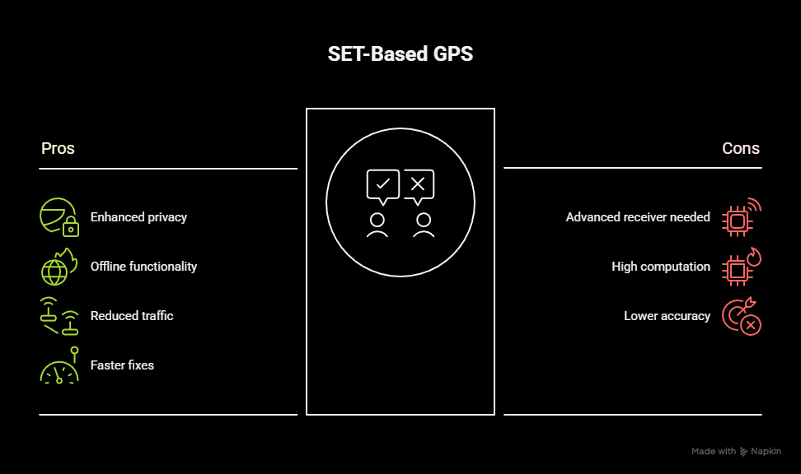

Slide 25
The Impact of SUPL
The impact of SUPL on GPS performance is dramatic:
Time To First Fix: Reduced from 30-60 seconds (cold start) to 5-10 seconds with SUPL assistance—a 6-10× improvement.
Accuracy: Improved from 10-30 meters (standalone GPS) to 5-10 meters with SUPL assistance, and 3-5 meters when combining multiple satellite constellations.
Power Consumption: Reduced by approximately 90% for position acquisition because the GPS receiver is active for only 5-10 seconds instead of 30-60 seconds.
Reliability in Weak Signals: With acquisition assistance, GPS receivers can often acquire and track signals that would be impossible to find through blind search, improving performance indoors and in urban environments.
User Experience: The difference between waiting 60 seconds and waiting 5 seconds for your first GPS fix is the difference between frustration and satisfaction. SUPL makes GPS practical for real-world use.

Slide 26
The Impact of SUPL: Performance Metrics
Time To First Fix (TTFF):
Scenario | Standalone GPS | A-GPS (SUPL) | Improvement
Cold Start | 30-60 seconds | 5-10 seconds | 6-10x faster
Warm Start | 20-30 seconds | 3-5 seconds | 6-8x faster
Hot Start | 5-10 seconds | 1-3 seconds | 3-5x faster
Factory Test | 2-5 minutes | 5-10 seconds | 24-60x faster
Definitions:
  Cold Start: No almanac, ephemeris, time, or position (Practical scenario: device off >4 hours)
  Warm Start: Has almanac but stale ephemeris, utc (Practical scenario: device off 1-4 hours)
  Hot Start: Recent almanac and ephemeris (Practical scenario: device off <1 hour)
  Factory Test: New device, never had GPS fix

